Slide 1
Fostering Confident Classroom Interaction
Richard Chinn

Slide 2
Aims of the workshop
To focus on classroom interaction & social science seminars
To explore barriers to classroom interaction.
To raise awareness of strategies for enhancing student participation and classroom interaction.
To apply strategies to teaching issues and teaching situations.

Slide 3
Task1: Exploring issues in your context
What are the perceived issues with interaction in your seminars?
What are some of the reasons for these issues?
Discuss with your group.
Create a poster to demonstrate these issues.
Notes:
30 mins

Slide 4
Classroom Interactional Competence (CIC)
Classroom Interactional Competence (CIC) is defined as, ‘teachers’ and learners’ ability to use interaction as a tool for mediating and assisting learning’ (Walsh 2013, p 65).
“It puts interaction at the centre of teaching and learning and argues that by improving their CIC, both teachers and learners will immediately improve learning and opportunities for learning.” (Walsh, 2021, p14)
Notes:
15 mins

Slide 5
CIC for HE Professionals
The notion of scholarship of teaching and learning (SoTL) is gaining credence in many higher education (HE) contexts (see, for example, McKinney 2006). (Walsh, 2021, p13)
“The scholarship of teaching and learning involves systematic study of teaching and learning and the public sharing and review of such work” (McKinney 2006, p 39)
“As previous studies have shown convincingly, understandings of teaching and learning can be enhanced through a detailed understanding of interaction.” (Walsh, 2021)

Slide 6
CIC focuses on the ways in which teachers’ and learners’ interactional decisions and subsequent actions enhance learning and learning opportunity. It addresses questions such as:
How are new concepts, ideas and knowledge co-constructed through interaction?
What do participants do to ensure that understandings are reached?
How do interactants address ‘trouble’ and repair breakdowns?
What is the relationship between CIC and learning in a university context?
How is ‘space for learning’ (Walsh & Li 2012) created and maintained?

Slide 7
Classroom discourse: IRF
Teacher (Initiation): "What is the capital of France?"
Student (Response): "Paris."
Teacher (Feedback): "Correct, well done! Number 3…”
Is this familiar?
Sinclair, & Coulthard, (1975)
What are the drawbacks regarding communication and this discourse pattern?
How might you alter the teacher’s response to encourage communication?

Slide 8
Questions and Response
Effective questioning should promote interaction rather than just elicit correct answers.
Teachers often rely on display questions (those with known answers), which can limit learner engagement.
Drawing on Thornbury (1996) and Cullen (1998), Walsh (2013) advocates for more referential questions (open-ended questions that encourage learners to express ideas and opinions).
The importance of wait time after asking questions. It allows learners to process and respond more thoughtfully. This aligns with Tsui (1996), who stress the role of timing in fostering deeper responses.
See Walsh 2015 for a full description

Slide 9
Nominating students
Allwright and Bailey (1991) caution that learners should not be forced to contribute or take part in communication until they are ready (also see Choudhury, 2005).
Furthermore, more introverted learners may be high achieving despite being more reticent (Czerwionka, 2009).
However, teachers should give learners the opportunity to take part in class by nominating.

Slide 10
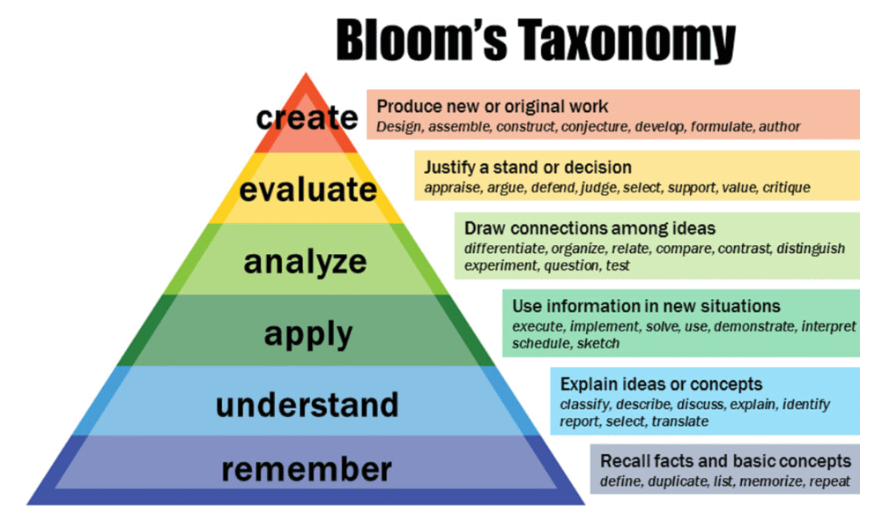
Anderson and Krathwohl, 2001

Slide 11
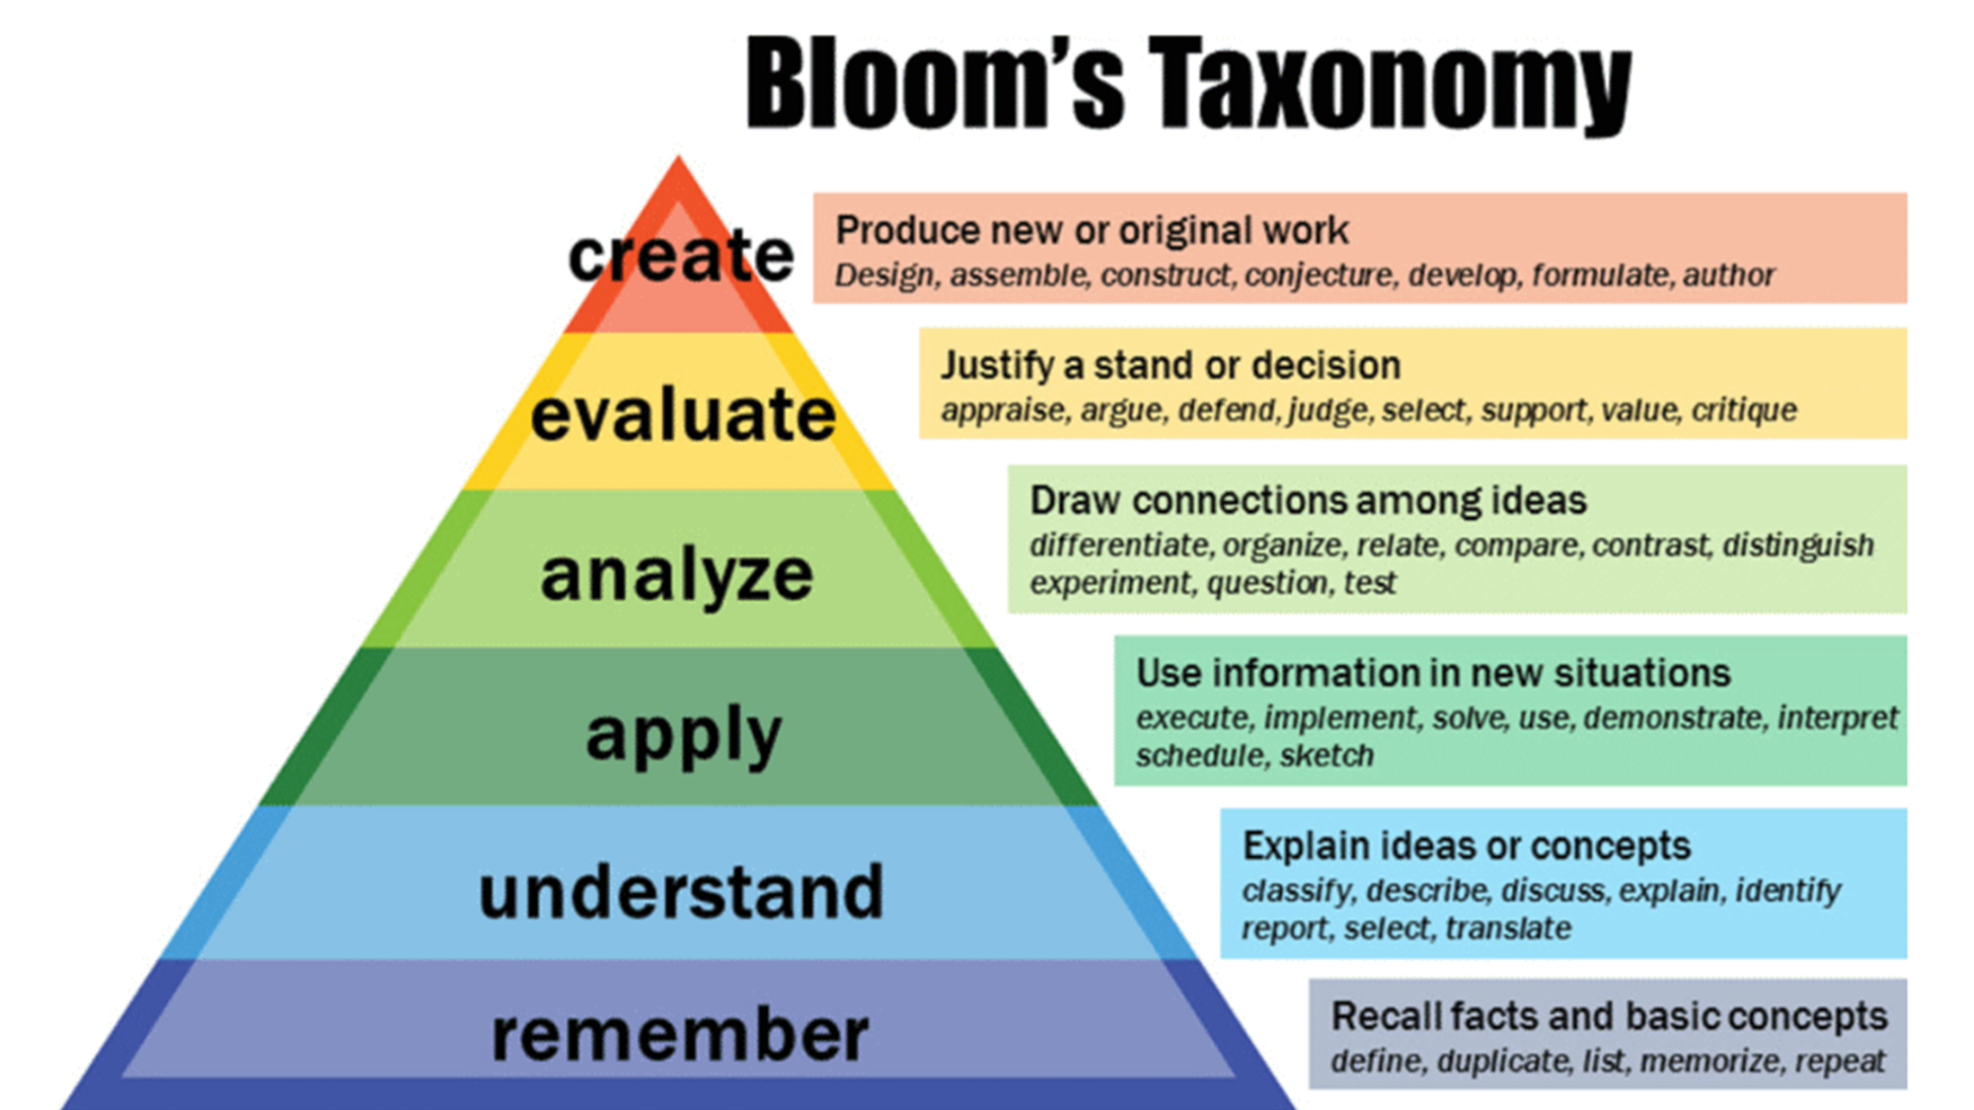
Task 2: Handout 1
Which sort of questions could you ask for each thinking skill?
Use the verbs to help you.
Look at the handout and compare your ideas
Notes:
5 mins m

Slide 12

Task 3: Exploring a lesson plan (Handout 2)
Read the text from the Guardian. What questions would you use to engage learners in the topic based on Bloom’s taxonomy.
Notes:
30 mins

Slide 13

Making Buzz Groups Work

Slide 14
Task 4: A Jigsaw/Information Gap
Would this work in your seminars? How could you adjust it to make it work?
Choose a topic that can be divided into several subtopics.
Divide students into home groups, usually four to six students per group.
Assign each member of the home group a different subtopic to become an expert in.
Regroup students into expert groups, putting together all students with the same subtopic.
Ask expert groups to read, discuss and learn their subtopic until they feel confident.
Provide guiding questions or tasks to structure their expert discussion.
Send students back to their original home groups.
Ask each student to teach their subtopic to their home group.
Encourage home groups to synthesise the information into a shared understanding or final product.
Debrief the activity by discussing what they learned and how the process went.
Notes:
5mins

Slide 15
Task 5: Strategies for classroom interaction
Put the cards face down.
Turn one over and discuss it. Does each card refer to before the seminar or during the seminar?
Can it address any of the issues identified on your poster?
Notes:
20 mins

Slide 16
Task 6: Moving beyond questions and using tasks
Which thinking skills are used below?
Listing
Ordering and Sorting (including sequencing, ranking, classifying)
Matching
Comparing
Problem‑solving
Sharing personal experiences
Projects and creative tasks
(Willis & Willis, 2007)
Notes:
5 mins

Slide 17
Task 7.1: Giving instructions
Imagine you need to give a new TA help with giving instructions. What advice would you give?
Keep instructions short and simple
Learners process spoken information quickly, so instructions must be:
Brief
Clear
Sequential
Example :“Look at the question on the board. Talk with your partner for 5 minutes. Make notes and prepare 2 key points to share.
Avoid adding unnecessary explanations in the middle. Offer the task first, support later.
Notes:
10mins for 71,2,3,

Slide 18
Task 7.2: Gesture & Voice
What gesture could you use for these instructions?
How would you use your voice in each one?
Work in pairs.
Work in groups of 3.
Come back together.
Look at me/Listen to me.
Look at the board.
Talk to each other

Slide 19
Task 7. 3: How to mix students up
Instructions:
Give learners a number.
Tell learners to stand up.
Regroup by number.

Slide 20
Task 8: Scenario & Practice
Use the Climate text from the guardian and the questions.
In your group plan how which strategies you would like to try out.
Take it in turns to role play parts of the lesson using some of the strategies.
Notes:
15 mins

Slide 21
Task 9: Developing Reflective Practice
Choose selected strategies to work on.
Reflect on which worked and if they didn’t, why didn’t they.
Plan to try out the strategy again.
Skills acquisition allows tutors to improvise.

Slide 22
Task 10: Reflection
Which strategies do you think might work for you?
How might you use some of them in your forthcoming classes?
Notes:
10 mins + fb

Slide 23
Some References
(contact me if you have questions about any not included on this slide)
Anderson, L.W., and Krathwohl, D.R. (2001) A Taxonomy for Learning, Teaching and Assessing: A revision of Bloom’s Taxonomy of Educational Objectives: Complete edition. Longman, Inc.
McKinney, K. (2006). Attitudinal and structural factors contributing to challenges in the work of the scholarship of teaching and learning. New directions for institutional research, 2006(129), 37-50.
Walsh, S. (2011) Exploring classroom discourse. Routledge.
Walsh, S. (2013). Classroom discourse and teacher development. Edinburgh University Press.
Walsh, S. (2021). Classroom interactional competence and evidence-based reflection. In D. Dippold & M. Heron (Eds.), Meaningful teaching interaction at the internationalised university (pp. 13–24). Routledge. https://doi.org/10.4324/9780429329692-2[1]
Willis, D. and Willis, J. (2007). Doing Task‑Based Teaching. Oxford University Press.

Slide 24
Thank you
Richard.1.chinn@kcl.ac.uk

